Slide 1
Fetch Me a Pen Literacy Techniques in Science
Spring/Summer 2015
Tasneem Mithawala & Raphael Richards

Slide 2
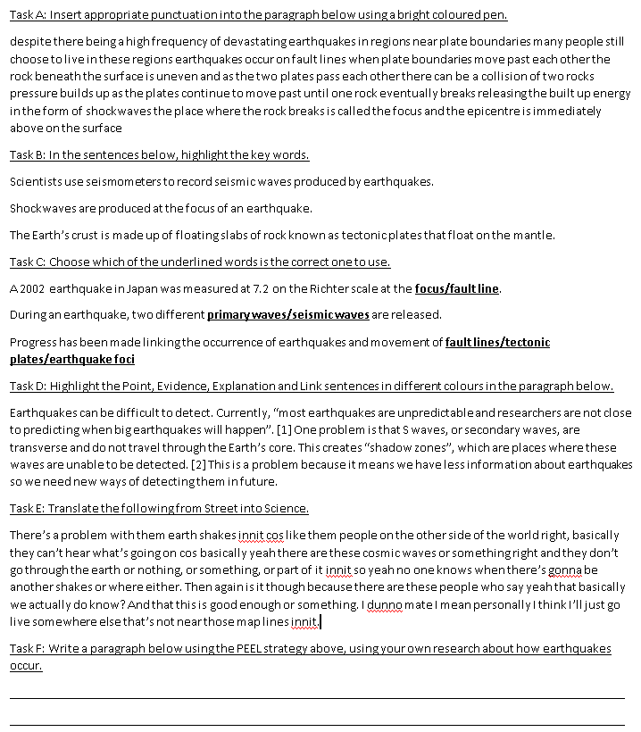
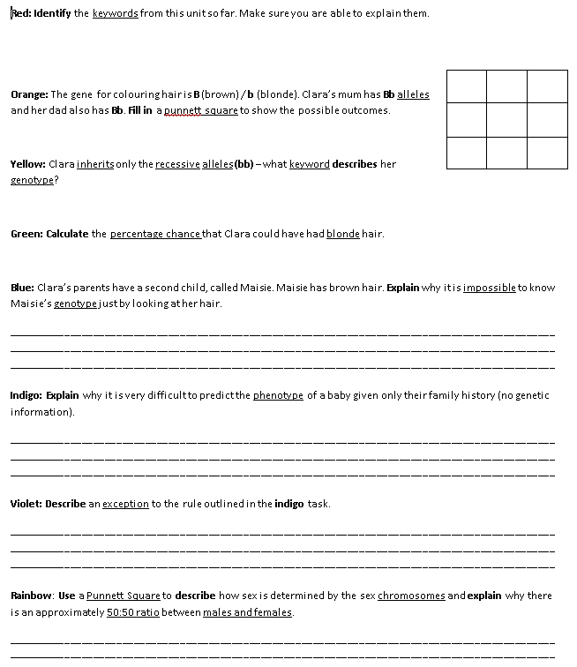

Slide 3
Pre-task research activity
Students were put in groups to research the effects of different drugs on the body
The minimum requirements for the following main task were displayed
30 minutes

Slide 4
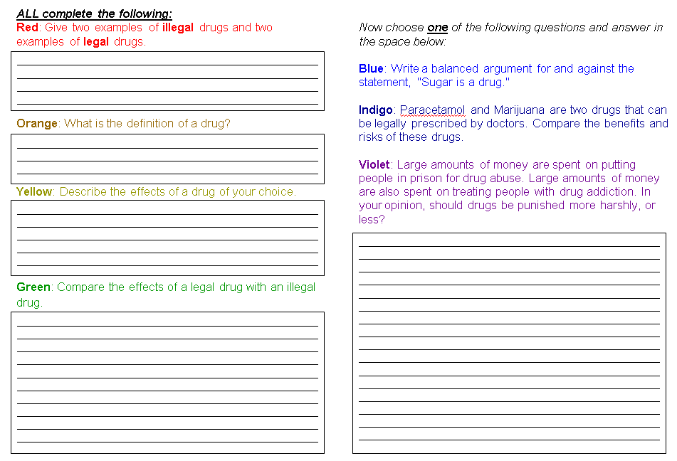
Main literacy task
The first four questions were compulsory and gradually increased in difficulty
The final long-answer question was a choice between:
an easier “blue” question,
a moderate “indigo” question, and
a harder “violet” extension, which offered a wider context for the lesson (SMSC)

Slide 5
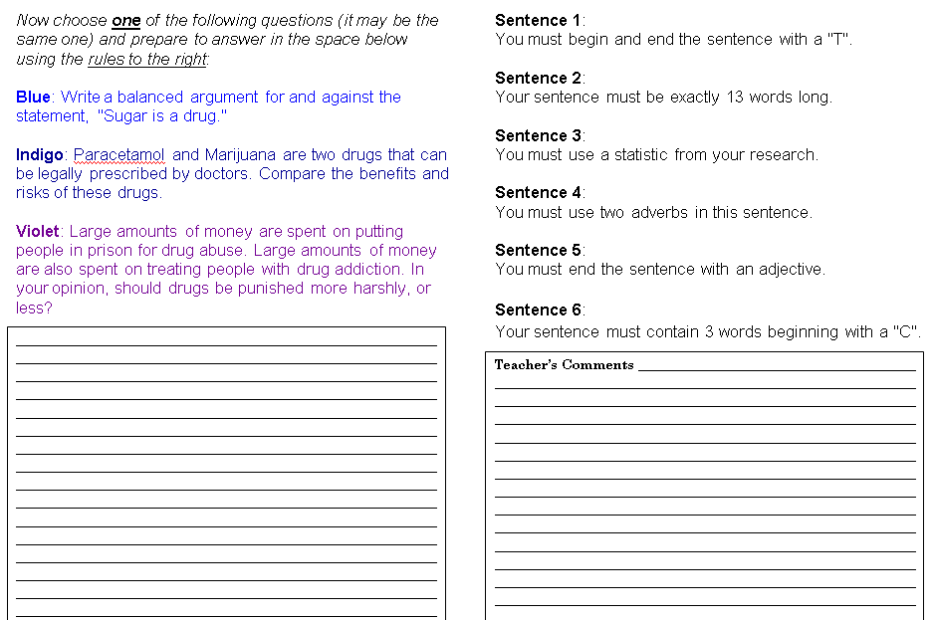
Slow writing task
Students were then given a second opportunity to tackle either the same question as before or a new question, this time using some slow writing techniques.

Slide 6
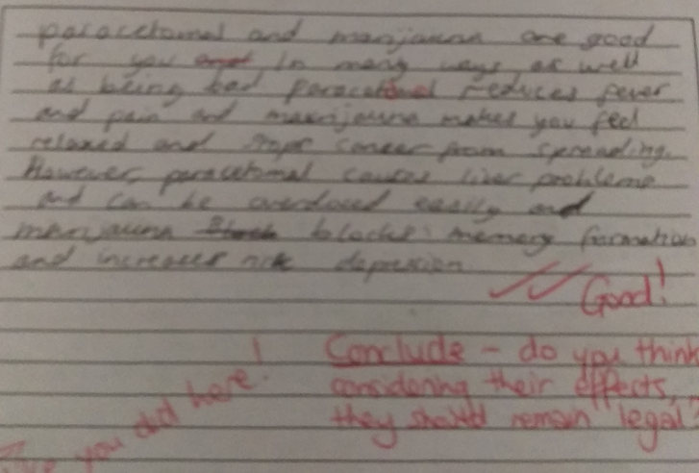
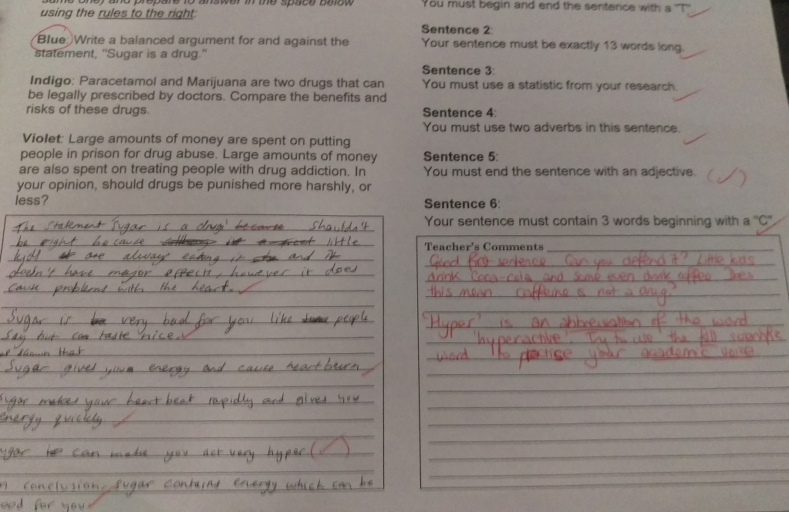
Examples of work Student A (LAP)
Student A found it extremely difficult to write without guidance
Even though the guidance was not connected to the topic, the slow writing answer was much better

Slide 7
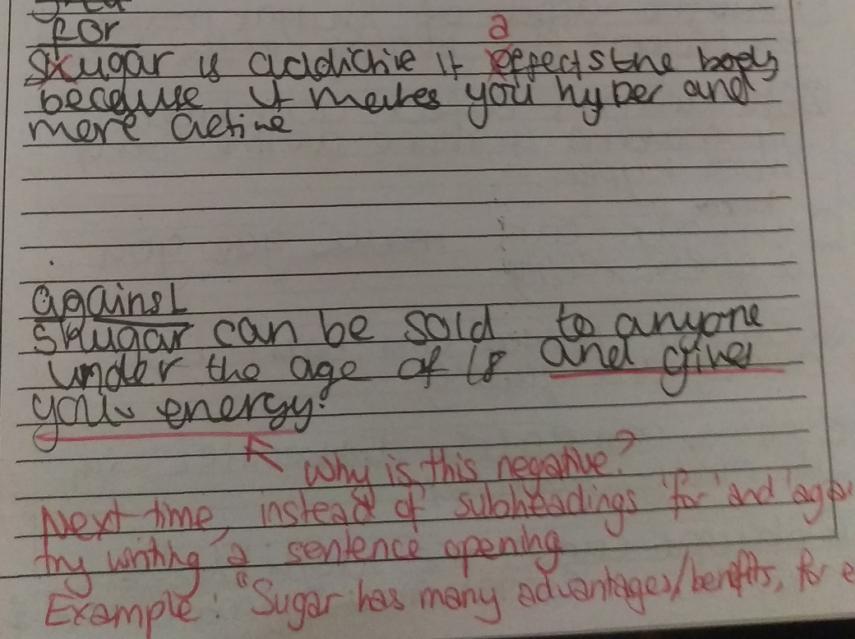
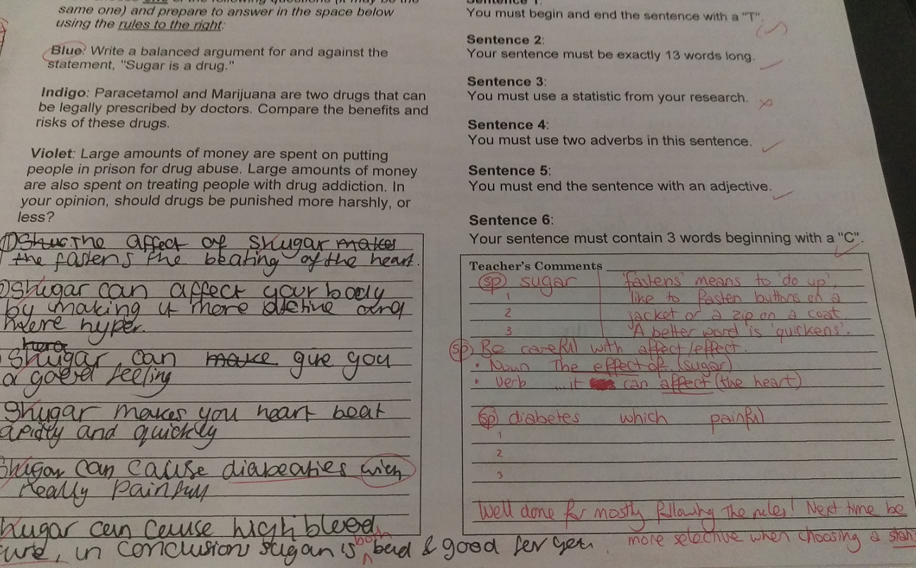
Examples of work Student B (LAP)
Student A found it extremely difficult to write without guidance
Even though the guidance was not connected to the topic, the slow writing answer was much better

Slide 8
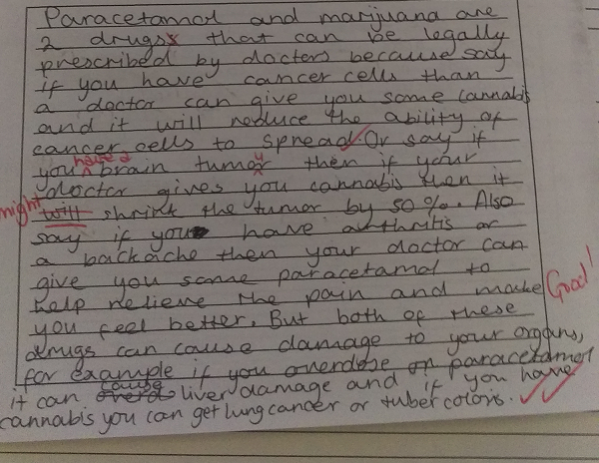
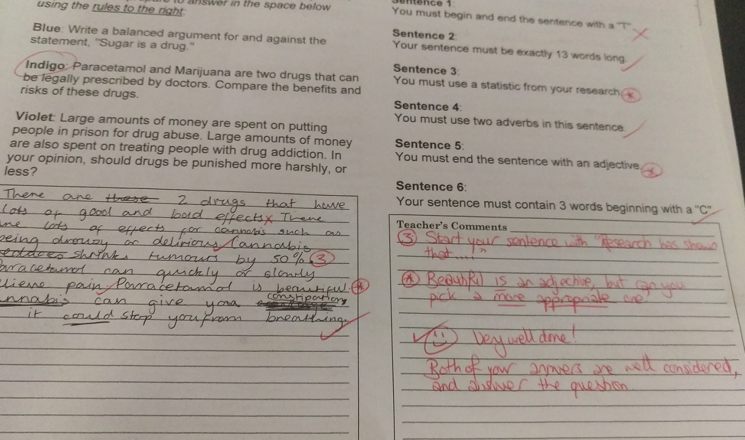
Examples of work Student C (MAP)
Student B found it easier to write coherently when not using the slow writing rules and felt constrained by having to conform to unfamiliar guidelines.

Slide 9
Speak, Scribble, Translate!
One person in your pair will be the speaker – this person will verbally answer the question on the board
Your partner will write down everything that you say
Word for word!
Make sure to write down everything!
You will then ‘translate’ this into a written explanation – LATER!

Slide 10
For example...
(someone was asked to explain how a school works)
“Well, basically, you have all the kids and they sit in the classroom, and learn stuff from a teacher. There’s a head teacher, but she doesn't have a classroom, and other teachers do... I think that’s it. Oh no, wait... You have different lessons in different rooms. Yeah.”
In your groups, discuss how you could translate this!

Slide 11
Speak your answer to your partner:
The body has a number of natural defences. Identify three and explain how each one prevents microbes from entering the body

Slide 12
Work together to translate your spoken explanations into written ones
Things to remember:
Imprecise pronouns – it, they...
Word order – does it make sense?
Order of ideas – could you arrange the ideas in a more coherent way?
Others?

Slide 17
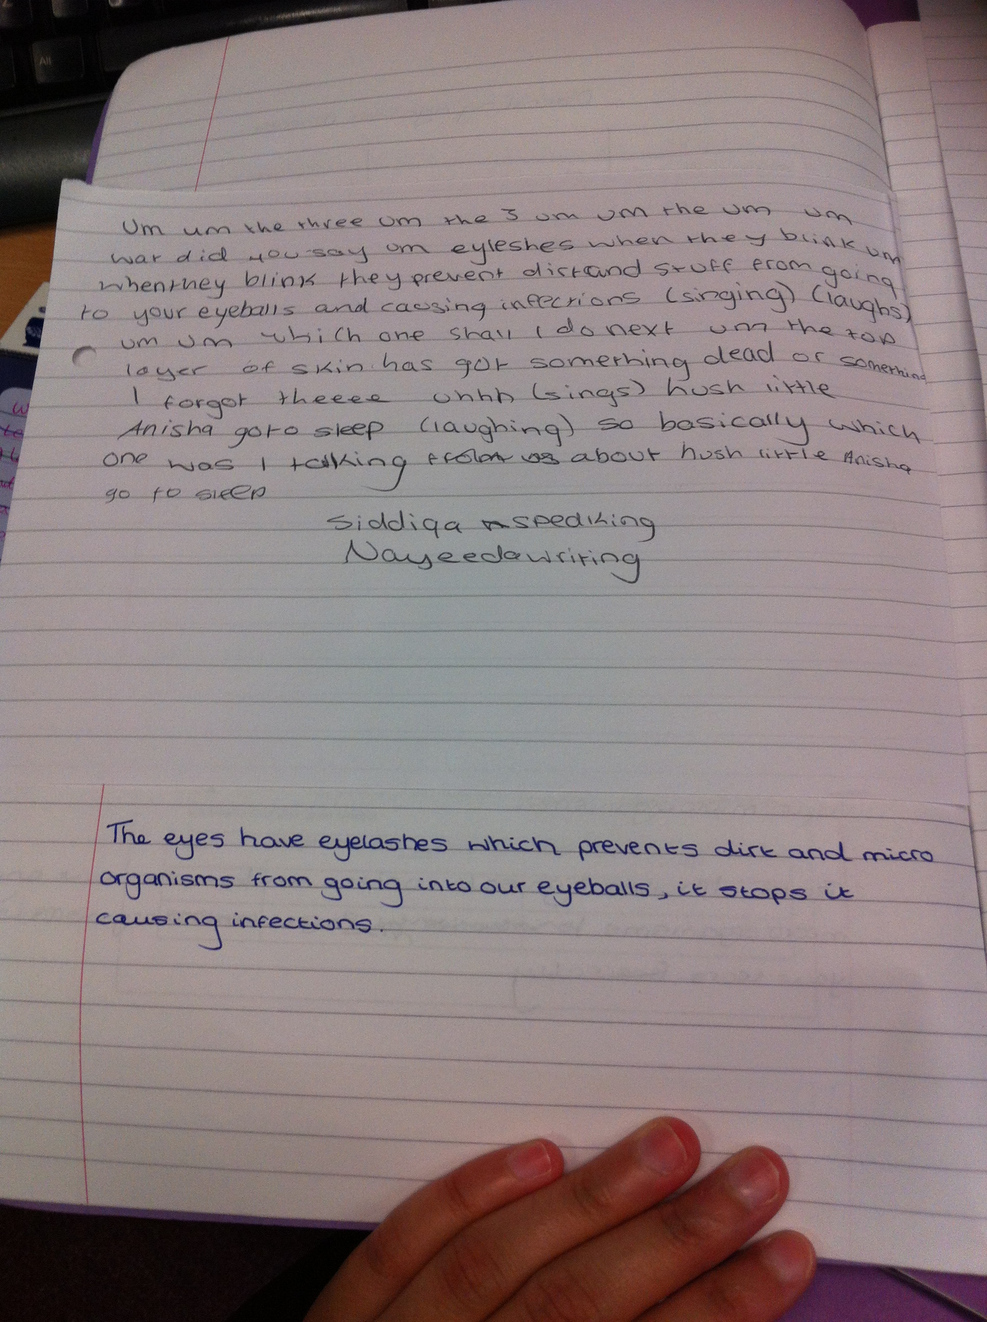

Slide 18
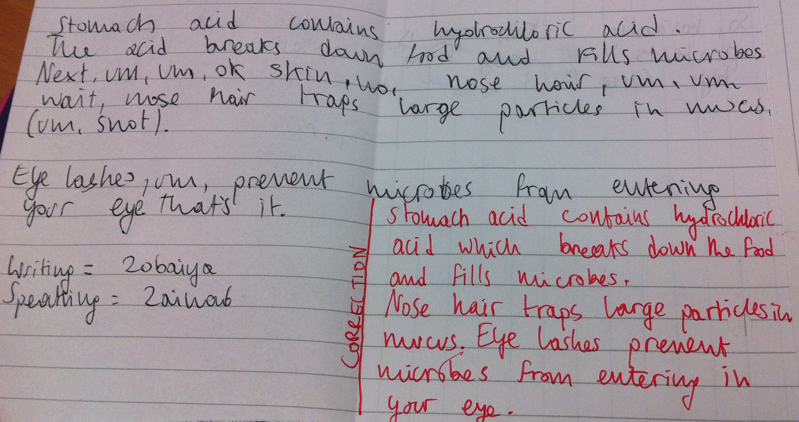

Slide 19
Fetch Me a Pen Literacy Techniques in Science
Spring/Summer 2015
Tasneem Mithawala & Raphael Richards

